Slide 1
Significant Digits
& Scientific Notation

Slide 2

What are significant digits?
The significant digits in a measurement consist of all the digits known with certainty plus one final digit, which is uncertain or is estimated.

Slide 3
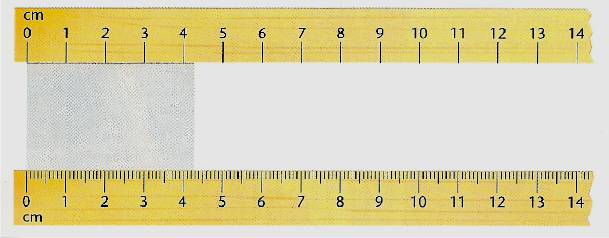
For example: Study the diagram below.
Using the ruler at the top of the diagram, what is the length of the darker rectangle found in between the two rulers?
Answer: The length is between 4 and 5 cm. The “4” is certain, but the distance past 4 cm will have to be estimated. A possible estimate might be 4.3. Both of these digits are significant. The first digit is certain and the second digit is uncertain because it is an estimate.

Slide 4
Using the ruler at the bottom of the diagram, what is the length of the darker rectangle found in between the two rulers?
Answer: The edge of the rectangle is between 4.2 cm and 4.3 cm. We are certain about the 4.2, but the next digit will have to be estimated. As possible estimation might be 4.27. All three digits would be significant. The first two digits are certain and the last digit is uncertain.

Slide 5
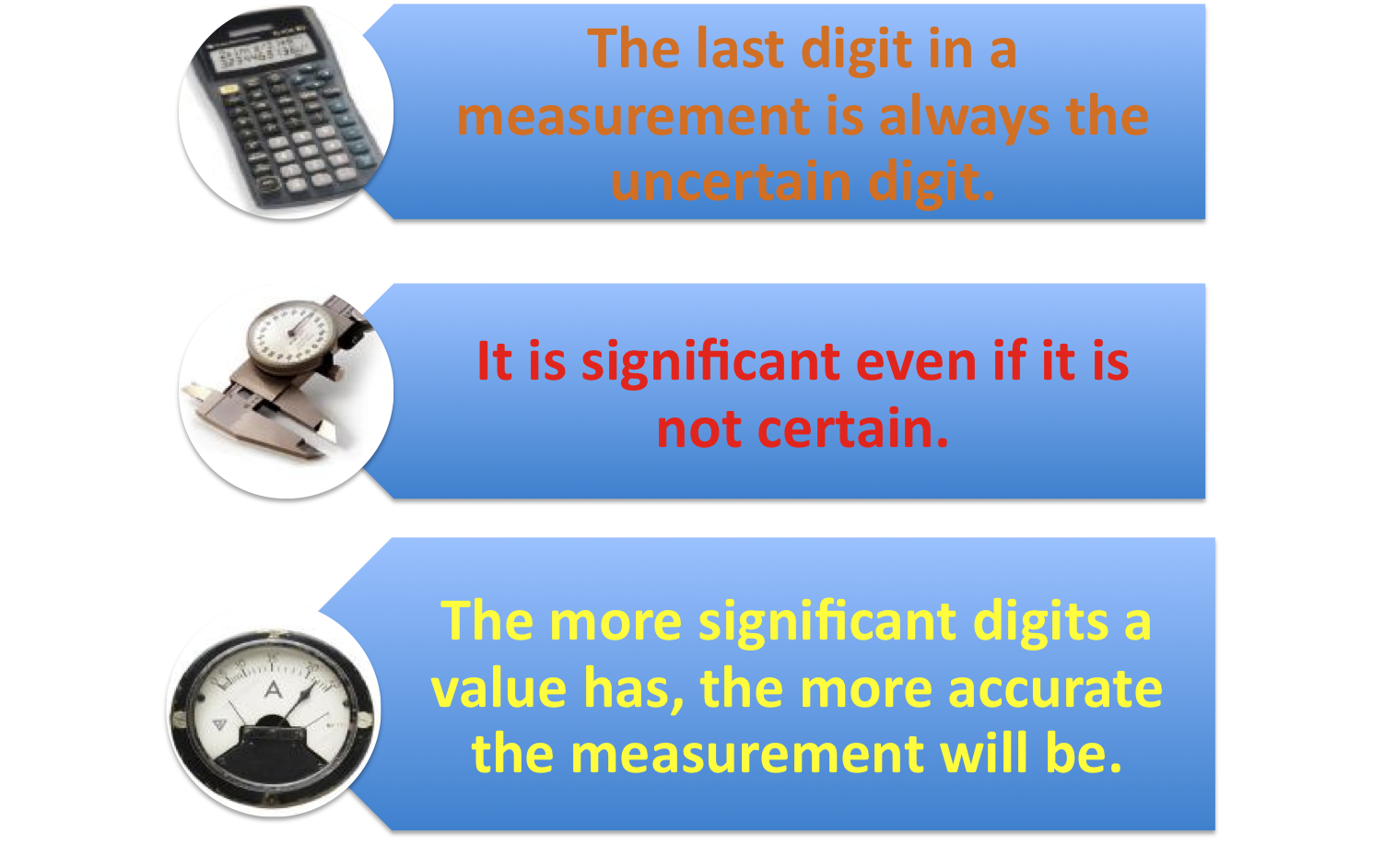
Please remember…

Slide 6
Remember!!
1. Significant figures apply to measured values. They are significant to the measurement NOT the number.
2. The number of significant figures is determined by the resolution of the instrument used to make the measurement. The last digit in a measured number is always the “estimated” digit.

Slide 7
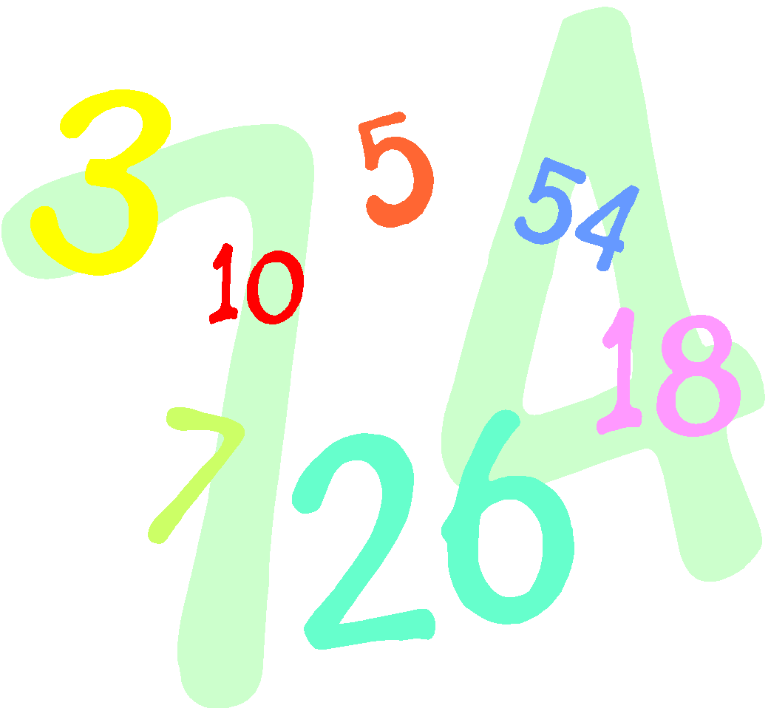

THERE ARE QUITE A FEW RULES THAT DETERMINE HOW MANY SIGNIFICANT DIGITS A MEASUREMENT HAS. YOU WILL NEED TO MEMORIZE THESE RULES.

Slide 8
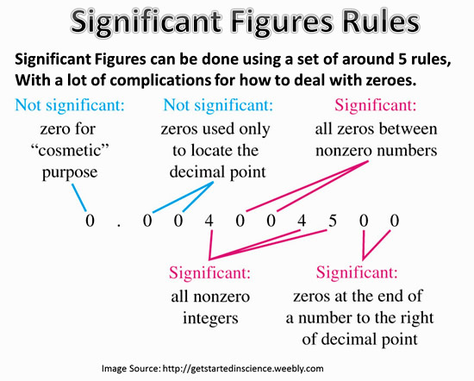
Rules Summary - We will go through each on the following slides
http://passyworldofmathematics.com/significant-figures/

Slide 9
RULE: If a number contains no zeros, all of the digits are significant.
How many significant digits are in each of the following examples?
a) 438
b) 26.42
c) 1.7
d) .653
Answers:
3
4
2
3

Slide 10
RULE: All ‘Captured’ zeros ( ones between two non zero digits) are significant.
How many significant digits are in each of the following examples?
a) 506
b) 10,052
c) 900.431
Answers:
3
5
6

Slide 11
RULE: Zeros to the right of a non zero digit a) If they are to the right of a nonzero number but not ‘Captured’ between nonzero and decimal point, they are not significant.
Answers:
3
1
1
How many significant digits are in each of the following examples?
a) 4830
b) 60
c) 4,000

Slide 12
RULE: Zeros to the right of a non zero digit b) If these zeros are ‘captured’ between a nonzero number and a decimal point, they are significant.
How many significant digits are in each of the following examples?
a) 4830.
b) 60.
c) 4,000.
Answers:
4
2
4

Slide 13
RULE: Leading Zeros are never significant. They are simply place holders.
How many significant digits are in each of the following examples?
a) 0.06
b) 0.0047
c) 0.005
Answers:
1
2
1
Try converting these to scientific notation. Compare it to the number of significant digits.

Slide 14
RULE: All zeros to the right of a decimal point and to the right of a non-zero digit are significant. They indicate the degree of accuracy in the measurement.
How many significant digits are in each of the following examples?
a) .870
b) 8.0
c) 16.40
d) 35.000
e) 1.60
Answers:
3
2
4
5
3

Slide 15

Practice Problems
Answers:
3
4
7
2
3
6
4
5
1
3
How many significant digits are in each of the following examples?
1) 47.1
2) 9700.
3) 0.005965000
4) 560
5) 0.0509
6) 701.905
7) 50.00
8) 50.012
9) 0.000009
10) 0.0000104

Slide 16
Determining Significant Digits When Rounding
1) 689.683 grams (4 significant digits)
2) 0.007219 (2 significant digits)
3) 4009 (1 significant digit)
4) 3.921 x 10⁻¹ (1 significant digit)
5) 8792 (2 significant digits)
6) 309.00275 (5 significant digits)
7) .1046888 (3 significant digits)
689.7
0.0072
4000
4 x 10⁻¹
8800
309.00
7) .105

Slide 17

Rule for Addition and Subtraction
When adding or subtracting, round the sum or difference so that it has the same number of decimal places as the measurement having the fewest decimal places. {you can only be as accurate as the LEAST accurate measurement}
Example: Add 369.3389 + 17.24
First simply add the two numbers. Answer = 386.5789
17.24 had the fewest number of decimal places with 2 places past the decimal. The above answer will have to be rounded to two places past the decimal.
Rounded Answer = 386.58

Slide 18
Find the sum or difference of the following and round them to the correct number of digits.
a) 39.61 – 17.3
b) 1.97 + 2.700
c) 100.8 – 45
d) 296.0 + 3.9876
Answers
22.3
4.67
56
300.0

Slide 19
Rule for Multiplication and Division
Express a product or a quotient to the same number of significant figures as the multiplied or divided measurement having the fewer significant figures.
Example: Multiply 6.99 x .25
First simply multiply the two numbers. Answer = 1.7475
.25 had the fewest number of significant digits with 2. The above answer will have to be rounded to two significant digits.
Rounded Answer = 1.7

Slide 20
Multiply or divide the following and give your answer in the correct number of significant digits.
a) 4.7929 ÷ 4.9
b) 5 x 3.999
c) 84 ÷ .09
d) .815 x 215.7
Answers
0.98
20
900
176

Slide 21
Scientific Notation
a way to express very small or very
large numbers that is often used in
"scientific" calculations where the
analysis must be very precise.

Slide 22
To Change from Standard Form to Scientific Notation:
(1) Place decimal point such that there is one
non-zero digit to the left of the decimal point.
(2) Count number of decimal places the
decimal has "moved" from the original
number. This will be the exponent of the 10.
(3) If the original number was less than 1, the
exponent is negative; if the original number
was greater than 1, the exponent is positive.

Slide 23
Example
The number: 4,750,000
Add the decimal point: 4,750,000.
Move the decimal so there is only ONE number (greater than 0) before the decimal:
4.75 (moved 6 decimal places)
answer: 4.75 X 10⁶
The original number was greater than 1 so the exponent is positive.

Slide 24
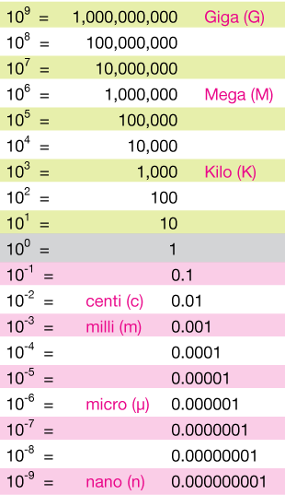
From: https://xaktly.com/ScientificNotation.html

Slide 25
Example
How does this relate to Significant Figures?
The number: 0.000789
Move the decimal so there is only ONE number (greater than 0) before the decimal:
7.89 (moved 4 decimal places RIGHT)
answer: 7.89 X 10⁻⁴
The original number was less than 1 so the exponent is negative.

Slide 26
To Change from Scientific
Notation to Standard Form:
(1) Move decimal point to RIGHT for POSITIVE exponent of 10.
(2) Move decimal point to LEFT
for NEGATIVE exponent of 10.

Slide 27
Example with positive exponent
Convert 5.023 x 10⁵
Move the decimal and write standard notation:
Answer: 502300

Slide 28
Example with negative exponent
Convert 5.023 x 10⁻⁵
Move the decimal and write standard notation:
Answer: 0.00005023

